Slide 1

AWS Database Services
Lesson 05: AWS Database services
Notes:
Add instructor notes here.

Slide 2
Lesson Objectives
In this lesson, you will learn:
Amazon RDS
Amazon ElastiCache
Amazon Dynamo DB
Notes:
Amazon RDS
Amazon ElastiCache
Amazon Dynamo DB
This lesson is to give an Introduction on Java Server Pages

Slide 3
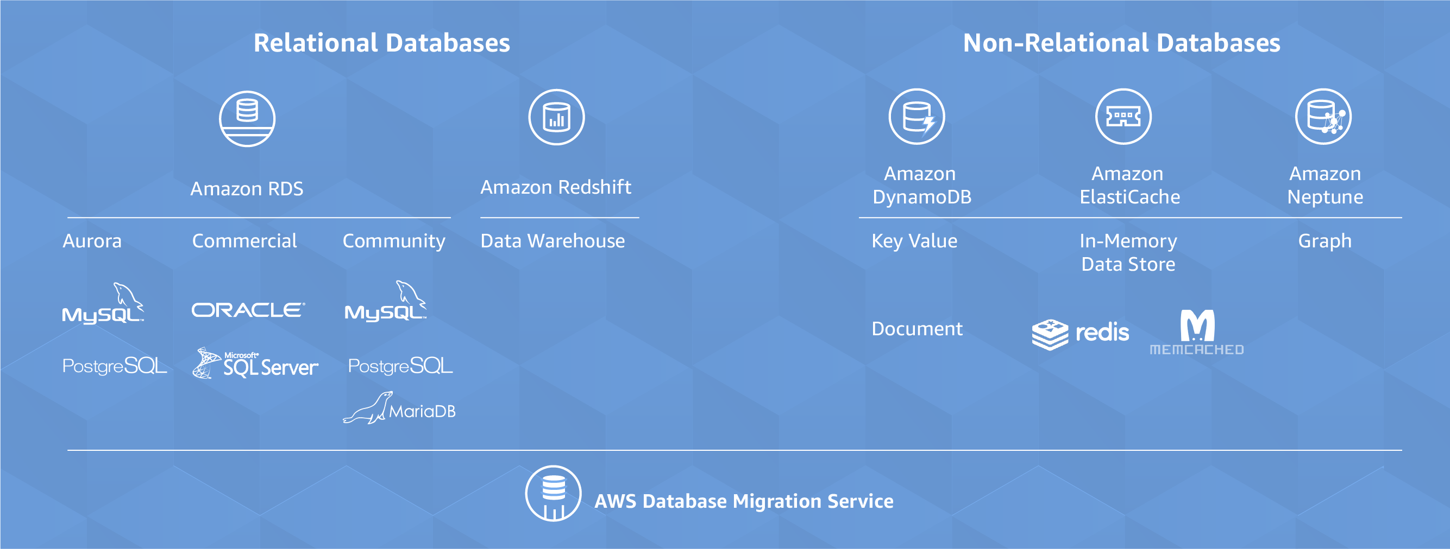

6.1: Amazon RDS Amazon Database Services
AWS offers a broad range of databases services to the user.
Notes:
AWS Database services are
Relational databases
non-Relational databases
Data warehouse
In-memory data store
Graph database
AWS Database Migration Service makes it easy and cost effective to migrate any one existing databases to AWS

Slide 4
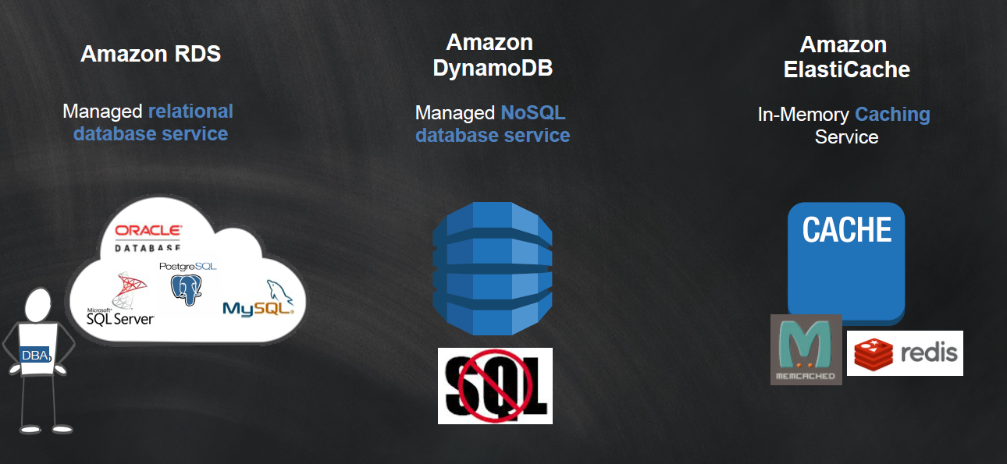
5.1: Amazon RDS Amazon Storage Services
.

Slide 5
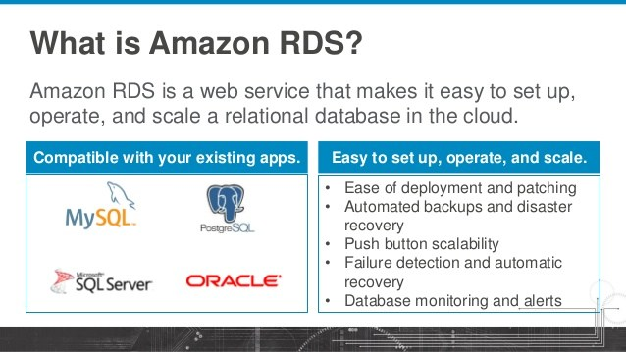
5.1: Amazon RDS Amazon RDS
It is a managed relational database in the cloud which can be launched in minutes with just a few clicks..
Notes:
Amazon RDS - offers a variety of database services.
Runs MySQL, Oracle, or SQL Server database engine on AWS.
Free Usage - YES
750 hours per month of a t1.micro
DB instance
20 GB of DB storage
20 GB of backups
10 million I/O operations
With Amazon RDS ,the code, applications, and tools we already use today with our existing databases can be used with Amazon RDS.
Amazon RDS automatically patches the database software and backs up your database, storing the backups for a retention period that you define and enabling point-in-time recovery.
You benefit from the flexibility of being able to scale the compute resources or storage capacity associated with your relational database instance by using a single API call.
In addition, Amazon RDS makes it easy to use replication to enhance availability and reliability for production databases and to scale out beyond the capacity of a single database deployment for read-heavy database workloads In addition, Amazon RDS makes it easy to use replication to enhance availability and reliability for production databases and to scale out beyond the capacity of a single database deployment for read-heavy database workloads

Slide 6
5.1: Amazon RDS Amazon RDS(Relational Database Service)
It is easy to Administer :--
Amazon RDS makes it easy to go from project conception to deployment. No need for infrastructure provisioning, and no need for installing and maintaining database software.
Highly Scalable :-
You can scale your database's compute and storage resources with only a few mouse clicks or an API call, often with no downtime.
Available and durable :-
When you provision a Multi-AZ DB Instance, Amazon RDS synchronously replicates the data to a standby instance in a different Availability Zone (AZ). Amazon RDS has many other features that enhance reliability for critical production databases, including automated backups, database snapshots, and automatic host replacement.

Slide 7
6.1: Amazon RDS Amazon RDS(Continuing…)
Fast
Secure :-
Amazon RDS also lets you run your database instances in Amazon Virtual Private Cloud(Amazon VPC), which enables you to isolate your database instances and to connect to your existing IT infrastructure through an industry-standard encrypted IPsec VPN.
Inexpensive :-
You pay very low rates and only for the resources you actually consume
Notes:
With Amazon RDS ,the code, applications, and tools we already use today with our existing databases can be used with Amazon RDS.
Amazon RDS automatically patches the database software and backs up your database, storing the backups for a retention period that you define and enabling point-in-time recovery.
You benefit from the flexibility of being able to scale the compute resources or storage capacity associated with your relational database instance by using a single API call.
This means that the code, applications, and tools you already use today with your existing databases can be used with Amazon RDS. Amazon RDS automatically patches the database software and backs up your database, storing the backups for a retention period that you define and enabling point-in-time recovery. You benefit from the flexibility of being able to scale the compute resources or storage capacity associated with your relational database instance by using Overview of Amazon Web Services March 2013
a single API call. In addition, Amazon RDS makes it easy to use replication to enhance availability and reliability for production databases and to scale out beyond the capacity of a single database deployment for read-heavy database workloads In addition, Amazon RDS makes it easy to use replication to enhance availability and reliability for production databases and to scale out beyond the capacity of a single database deployment for read-heavy database workloads

Slide 8

5.1: Amazon RDS Amazon RDS( How to work on )
The Amazon RDS console is a simple web-based user interface.
From the console, you can perform almost all tasks you need to do from the RDS console with no programming required.
To access the Amazon RDS console, sign in to the AWS Management Console and open the Amazon RDS console at
https://console.aws.amazon.com//rds/.
This demo shows how to create and connect to a DB instance using Amazon RDS.
We can create, or launch, a DB instance that uses MySQL, Oracle, PostgreSQL, and Microsoft SQL Server.

Slide 9
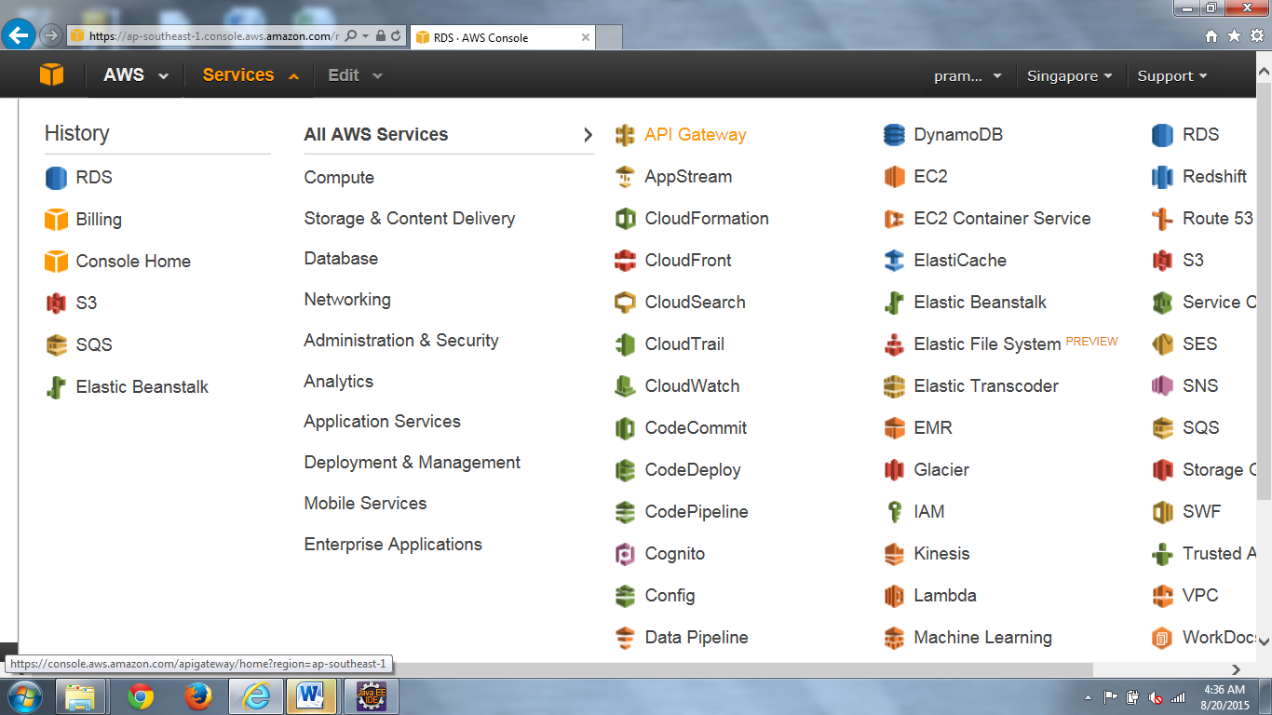
6.1: Amazon RDS Amazon RDS

Slide 10
5.1: Amazon RDS Amazon RDS Steps
In this example, we will create a DB instance running the Oracle database 10 GB of storage, and automated backups enabled with a retention period of one day.
To launch an Oracle DB instance-
Sign in to the AWS Management Console and open the Amazon RDS console at https://console.aws.amazon.com/rds/.
Select the region in which you want to create the DB instance.
In the navigation pane, click DB Instances.
Click Launch DB Instance to start the Launch DB Instance
Wizard.

Slide 11
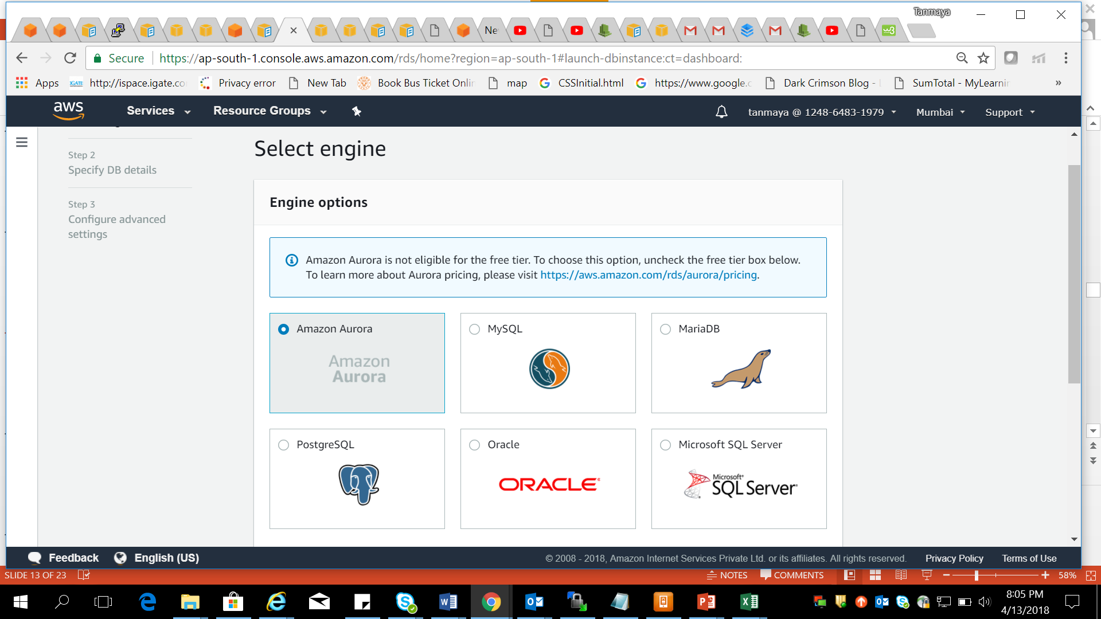
6.1: Amazon RDS Amazon RDS Steps( Continuing.. )

Slide 12
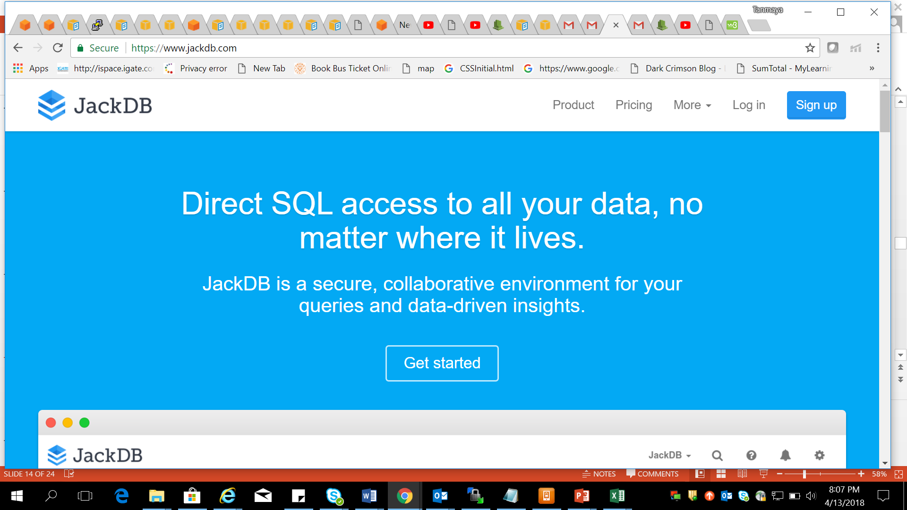

5.1: Amazon RDS JackDB
Notes:
JackDB :-
A database client - like psql or pgAdmin
works entirely in web browser
supports multiple db including PostgreSQL
Add Audit logging data source sharing
HTPPS and SSL with remote host verification
fine grained access control and multi level security policies

Slide 13
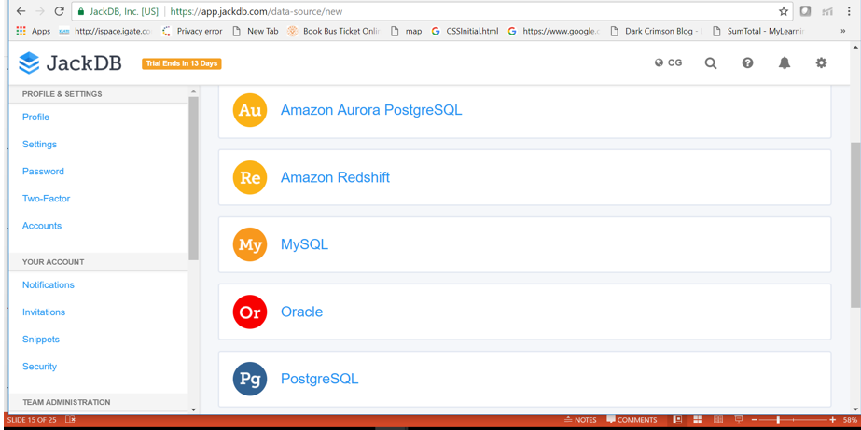
6.1: Amazon RDS JackDB

Slide 14
5.1: Amazon RDS Steps to launch DB instance of MySQL type in AWS RDS
In Amazon RDS dashboard click on the Launch DB instance link
Choose MySQL engine and click next
Choose Use case Dev/Test - MySQL
supports multiple db including PostgreSQL
Add Audit logging data source sharing
HTPPS and SSL with remote host verification
fine grained access control and multi level security policies
Notes:
1. In Amazon RDS dashboard click on the Launch DB instance link
2. Choose MySQL engine and click next
3. Choose Use case Dev/Test – MySQL
4. Specify DB details
DB instance class- db.t2.micro ( low space )
C reate replica in Different Zone
Storage type – general perpose
Storage – 20 gb
Settings
DB instance Identifier - LnD-java-mysql
User name - java
Password - Bangalore
6. Network and security –
Let it be default , pls don’t change anything
Database Options
DB name - LnD_DB_Mysql
Port – 3306
8. Click on DB launch instance
Once the instance is available , copy few things
Endpoint :- lnd-java-mysql.cryxdduifehe.ap-south-1.rds.amazonaws.com
Db name :-- LnD_DB_Mysql
Userid :-- java
password
check the security group -- Type (Any traffic ) and source – (Anywhere)

Slide 15
6.1: Amazon RDS Steps to Implent Query in jackDB
Type www.jackDb.comLogin to
Create a account and signIn
Add a Datasource of MySQL type
Enter DB credentials
Add Audit logging data source sharing
HTPPS and SSL with remote host verification
fine grained access control and multi level security policies
Notes:
1. Type www.jackDb.comLogin to
2.Create a account and signIn
3. Add a Datasource of MySQL type
4. Enter DB credentials
Name - LnD-Javalot-Jackdb-mysql
Host :- Endpoint name of RDS Db instance
Port :- 3306
User – java
Password – DB password from AWS RDS
Once Datasource created , connect it.

Slide 16
5.1: Amazon RDS Demo
Demo on:
Amazon RDS with JackDB
Notes:
MySQL query:
CREATE DATABASE mydb; USE mydb; CREATE TABLE mytable ( id INT PRIMARY KEY, name VARCHAR(20) ); INSERT INTO mytable VALUES ( 1, 'Will' ); INSERT INTO mytable VALUES ( 2, 'Marry' ); INSERT INTO mytable VALUES ( 3, 'Dean' ); SELECT id, name FROM mytable WHERE id = 1; UPDATE mytable SET name = 'Willy' WHERE id = 1; SELECT id, name FROM mytable; DELETE FROM mytable WHERE id = 1; SELECT id, name FROM mytable; DROP DATABASE mydb;

Slide 17
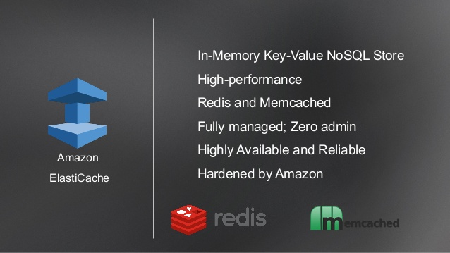
6.2: Amazon ElastiCache Amazon ElastiCache
Amazon ElastiCache makes it easy to deploy, operate, and scale an in-memory data store or cache in the cloud .
Notes:
This service improves the performance of web applications by allowing you to retrieve information from a fast, managed, in-memory caching system, instead of relying entirely on slower disk-based databases .
ElastiCache supports two open-source caching engines.
Memcached - a widely adopted memory object caching system . ElastiCache is protocol compliant with Memcached, so popular tools that you use today with existing Memcached environments will work seamlessly with the service.
Redis --- It is a popular open-source in-memory key-value store that supports data structures such as sorted sets and lists. ElastiCache supports Redis master / slave replication which can be used to achieve cross AZ redundancy

Slide 18
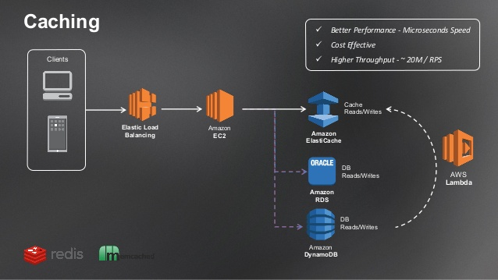
5.2: Amazon ElastiCache Amazon ElastiCache
Notes:
Amazon ElastiCache Redis Multi-AZ with Automatic Failover Open-Source Compatible Fully Managed Enhanced Redis Engine Easy to Deploy, Use and Monitor No Cross-AZ Data Transfer Costs Extreme Performance at Cloud Scale ElastiCache - Customer Value

Slide 19
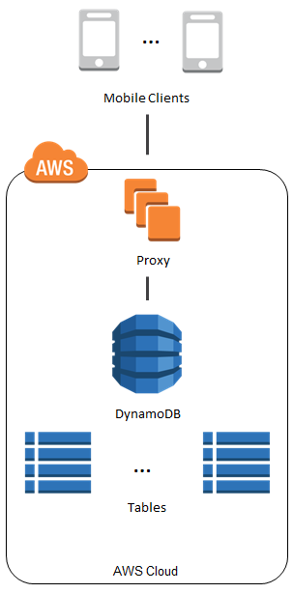
5.3: Amazon DynamoDB Amazon DynamoDB
It is a fast, fully managed NoSQL database service
which makes it simple and cost-effective to store
and retrieve any amount of data, and serve any
level of request traffic .
It is a fully managed cloud database and supports
both document and key-value store models.
It is flexible data model and reliable performance
make it a great fit for mobile, web, gaming
application.

Slide 20
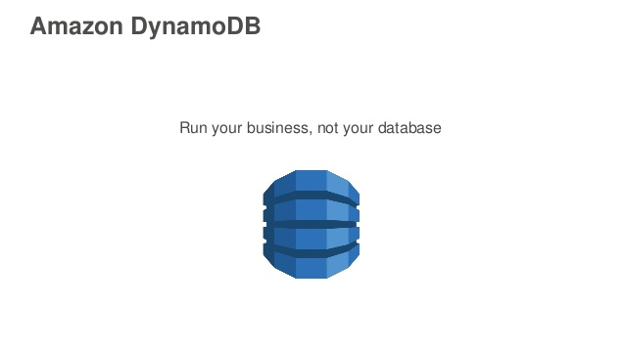
6.3: Amazon DynamoDB Amazon DynamoDB
It is a fast and flexible NoSQL database for any scale .
It helps the developer to don't have to worry about hardware provisioning, setup and configuration, replication, software patching, or cluster scaling.
DynamoDB is also provide secure way through encryption at rest, that removes the the operational burden and complexity involved in protecting sensitive data.
Amazon DynamoDB provides on-demand backup capability.
DynamoDB allows you to delete expired items from tables automatically to help to reduce storage usage and the cost of storing data that is no longer relevant .
Notes:
With DynamoDB, you can create database tables that can store and retrieve any amount of data, and serve any level of request traffic. You can scale up or scale down your tables' throughput capacity without downtime or performance degradation, and use the AWS Management Console to monitor resource utilization and performance metrics.

Slide 21
5.3: Amazon DynamoDB Amazon DynamoDB
DynamoDB automatically spreads the data and traffic for your tables over a sufficient number of servers to handle your throughput and storage requirements, while maintaining consistent and fast performance.
These are the benefits of DynamoDB
Highly Scalable
Fast Consistence Performance
Fully managed
Business critical reliability
Notes:
All of your data is stored on solid state disks (SSDs) and automatically replicated across multiple Availability Zones in an AWS region, providing built-in high availability and data durability. You can use global tables to keep DynamoDB tables in sync across AWS Regions.

Slide 22
Summary
In this lesson, you have learnt:
Amazon RDS
Amazon ElastiCache
Amazon DynamoDB

Slide 23
Review – Questions
Question 1: Amazon database services support both ___________ and _______________ databases.
Question 2 : _____________ AWS Database service supports Relational database to migrate to AWS ?
Question 3 : _______________makes it easy to deploy, operate, and scale an in-memory data store or cache in the cloud .
Notes:
Answers for the Review Questions:
Answer 1: Amazon Relational and Non-Relational
Answer 2: Amazon RDS
Answer 3: Amazon ElastiCache

Slide 24
Review – Questions
Question 3: _________ is a fully managed cloud database and supports both document and key-value store models.
Question 4: Which are the AWS Database storage ?
Option 1 : Amazon EBS
Option 2 : Amazon DynamoDb
Option 3 : Amazon Glacier
Option 4 : Amazon RDS
Notes:
Answers for the Review Questions:
Answer 3 AWS DynamoDb
Answer 4: Option 2 and Option4

